Slide 1
The Agile Inception Deck

Slide 2
Collection$
UAB EE433
Notes:
Project name – pick a cool sounding name for your project
Sponsors – list your project sponsors here (the people with the money)
Putting your sponsors name boldly out there for all to see is a great way to get their engagement and attention (necessary for any successful project).

Slide 3

Why are we here?
Helps identify unknown items in your collection.
Offers information about your collection, assisting with research, establishing value.
Connects collectors with others.
Creates and helps maintain
multiple collections
Notes:
Write down all the reasons why your company would want to spend money on this project in the first place.
Then pick and highlight the most important one.

Slide 4
The elevator pitch
For anyone with a collection
who needs help maintaining it efficiently
the software tool; Collection$
is a smartphone application
that contains collector-specific tools
Unlike time-consuming manual spreadsheet software such as Excel
our project contains tools for assisting with object identification, collection maintenance, collection-specific social networking, and expert value estimation of items

Slide 5
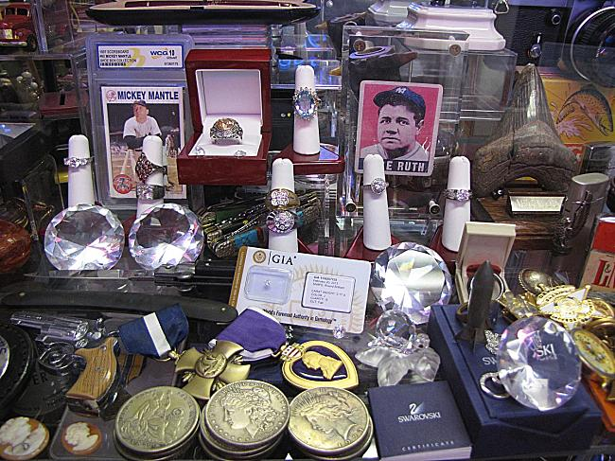
Product box
Collection$
Keep it organized!
Identifies Objects
Maintains your collection
Connects with others
Notes:
If you could walk into a store, and buy the shrink wrapped version of your software, what the design of the box look like and what would it say?
Point here is to get your team looking at your project through the eyes of your end customer.

Slide 6
The NOT list
IN | OUT
Mobile App, Secure Login, Cloud-Based | Web App (version 9.0)
Maintains your collection, CRUD items
Machine Identification (Amazon Turk?)
Social Networking with other collectors
UNRESOLVED
Amazon Turk vs. ‘real’ machine identification?
Fee or Free?
Notes:
List all the big ticket items you are (and are NOT) going to deliver within the scope of this project.
Before starting your project move all the UNRESOLVED ones to either IN or OUT.

Slide 7



Your project community
Beta Testers
Experienced
Collectors
Your core team
Ver 1.0
New Collectors
Experts
Everyone else !
... is always bigger than you think!
Notes:
List everyone you are going to have to interact with at some point during the course of your project.
Goal is to start building relationships with these people and let them know we are coming down the tracks (before we actually get there).

Slide 8



Technical solution
User Database
MySQL
Application
Collectors
Cloud Hosted
Database
Or Amazon Turk
Technologies:
Java
Eclipse
Android
Netbeans
Tomcat (server)
SmartPhones, Tablets
Danger!
Out of scope
Notes:
This is about letting people know how we plan on building this thing.
If there are any tools or libraries assumptions you are making list them here.
Also if there are areas of the application architecture that are risky highlight those too.

Slide 9

What keeps us up at night
Scope of projects too large
Machine identification fails to work
Collectors don’t find it effective
Inability to drive out bugs
Properly identify 2D and 3D objects
New platform for developers (android)
Notes:
This is your chance to call out any craziness you’ve heard while building the deck, and having a frank conversation with your sponsors and your team about how you are going to handle it.
This is perhaps on of the most powerful slides in the deck – it’s your chance to ask for whatever you need to be successful and the consequences if you don’t get it.
Use it!

Slide 10
The A-Team
# | Role | Competencies/Expectations
1 | Analyst | Comfortable with just-in-time analysis. Likes to test. Comfortable with rapid iterative development.
2 | Developers | C, Java, SQL, android Unit testing, refactoring, continuous integration
1 | Project manager | Responsible for outward facing communication Status reports, scope, budget, and reporting upwards
Notes:
Set expectations around who you are going to need and what kind of skills they will need to have to pull this off.
Use names if specific people are important (i.e. Billy is the only guy who can do X).

Slide 11

How big is this thing?
Ship it!
Training
(first group of users)
Construction
Testing
~3months
1 wk
1 wk
This is a guess. Not a commitment.
Notes:
Give your sponsors some idea of how big this thing is (1, 3, or 6 monther).
Before you can complete this slide you and the team should create and estimate a high-level story list for the project.
This isn’t a commitment (too many unknowns). It’s just a really rough guess. Don’t treat it as anything else.

Slide 12
Trade-off sliders
 | The classic four
 | Feature completeness (scope)
 | Stay within budget (budget)
 | Deliver project on time (time)
 | High quality, low defects (quality)
ON
OFF
ON
OFF
ON
OFF
ON
OFF
 | Other important things
 | Ease of use
 | Don’t make me think!
 | Detailed audits (log everything)
 | Customizable
ON
OFF
ON
OFF
ON
OFF
ON
OFF
Notes:
When push comes to shove, something has to give. Here we want to be clear on what that is.
On agile projects we flex on scope. But there could be others factors at play here so get ready to listen as you customer tells you which forces can bend (scope) and which are written in stone (usually budget).
Slider rules:
1. No two sliders can occupy the same level.
2. List other important project factors down below.

Slide 13
The first release
Ship it!
Construction
Testing
Deployment
~2months
1 wk
1 wk
4 people, 2 ½ months, $0
Notes:
Stakeholders are usually interested in two things:
How much is this going to cost.
When is it going to be done.
Here we do our best to answer those two questions so they can decide if the project is still worth doing by showing them what it’s going to take.

Slide 14

Learn more
http://agilewarrior.wordpress.com
Buy the book!
Twitter:
@jrasmusson
Notes:
That’s it! Create your deck.
Put it somewhere visible for all too see.
And update it when things change.
Good luck!

